Slide 1
Develop an OCR (Optical Character Recognition) system using generative Al models to extract text from images or documents for a document management company

Slide 2
Model Selection
Easy-ocr (For Image)
Tesseract-ocr (For Image)
Gemini(For Image)
IBM Deep search(For pdf)

Slide 3
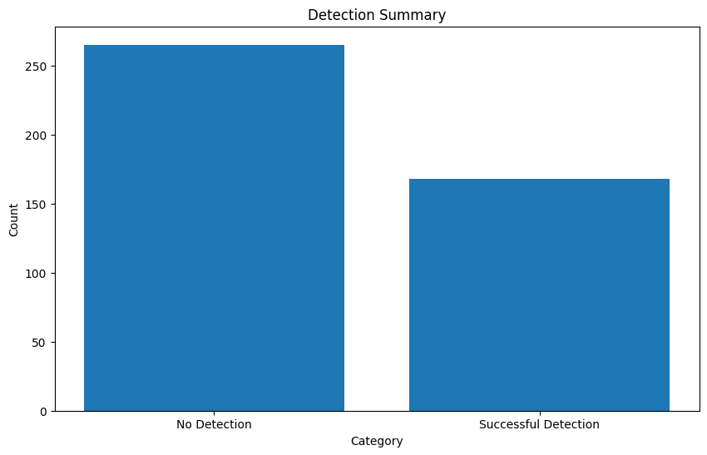
Detection Summary from image using Pytessaract

Slide 4
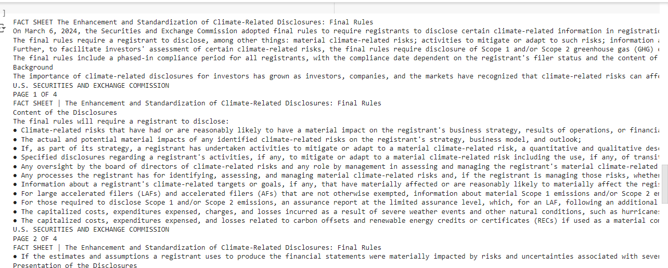
Detection from pdf

Slide 5
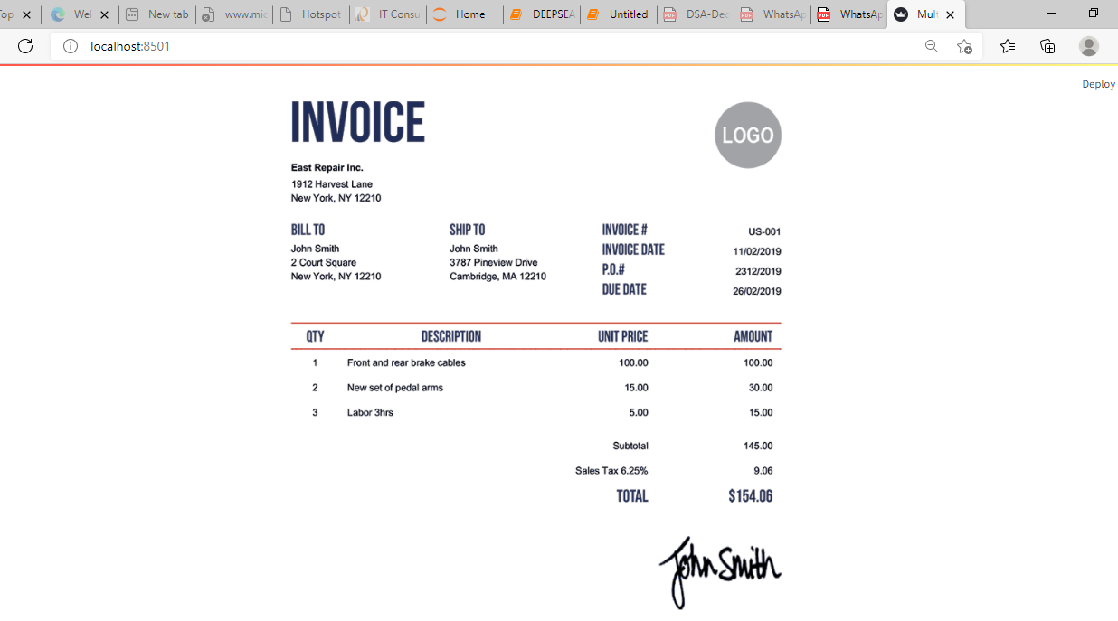
Source Image

Slide 6
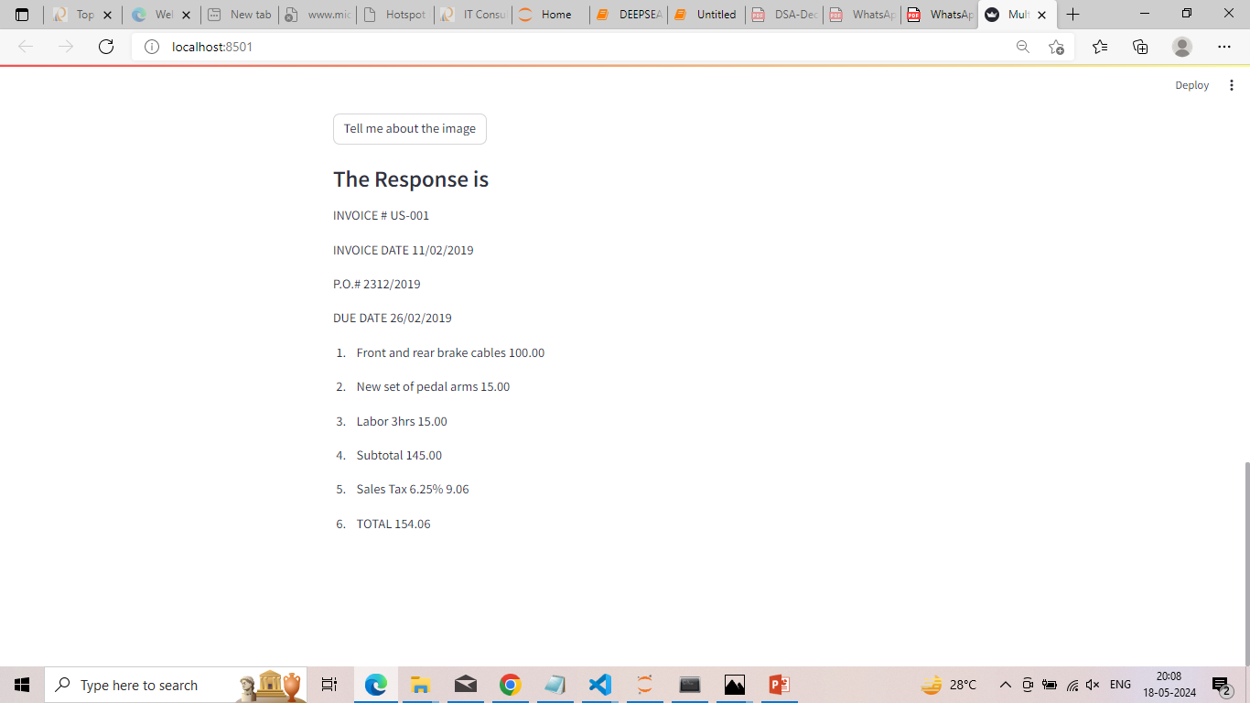
Extracted text from image

